Slide 1


CUT · COLOUR
COURSE SLIDES · NON-WSQ
Adobe Premiere Pro Masterclass
Course code C387
Duration 2 days · 15 instructional hours
Provider Tertiary Infotech Academy Pte Ltd · UEN: 201200696W
Version v12 · 21 August 2026
© 2026 Tertiary Infotech Academy Pte Ltd · C387

Slide 2
FACILITATOR TEMPLATE
General Trainer Profile
Industry practice
Training practice
?
Relevant video-editing and post-production experience.
Adult-learning and facilitation credentials.
TRAINER NAME
Course fit
Contact
Insert approved profile photo and professional designation before delivery.
Examples aligned to learner productions and delivery channels.
Approved professional contact route.
Adobe Premiere Pro Masterclass · C387
2

Slide 3
TRAINER PROFILE
Dr Alfred Ang
Role
Expertise
Facilitation
Principal Trainer · Tertiary Infotech Academy
Digital transformation, AI, courseware and adult learning.
Concept-led explanation, coached edit decisions and evidence review.
Quality
Learning culture
Contact
Traceable versions, technical QC and clear acceptance criteria.
Explain why each cut, mix, grade and export choice fits the brief.
enquiry@tertiaryinfotech.com · +65 6100 0613
Adobe Premiere Pro Masterclass · C387
3

Slide 4
OPENING DISCUSSION
Your Video-Editing Context
Role
Channel
Friction
What video content do you create or review?
Web, social, training, corporate or documentary?
Which editing stage consumes the most time?
Quality
Experience
Evidence
Which picture or audio defect is most visible?
Which NLE or mobile editor have you used?
What finished sequence will demonstrate improvement?
Adobe Premiere Pro Masterclass · C387
4

Slide 5
GROUND RULES
Working Agreements
Participate
Respect
Protect media
Edit, test and explain decisions.
Critique the work, not the person.
Use supplied footage and do not publish it outside the course.
Version
Share safely
Verify
Preserve sources and use clear sequence/file names.
Protect learner work and project files.
Reopen every exported MP4 before hand-off.
Adobe Premiere Pro Masterclass · C387
5

Slide 6
LMS-TMS · LEARNER PACKAGE
Download Course Materials
lms-tms.tertiaryinfotech.com
Adobe Premiere Pro Masterclass
Courseware · v12
PPTX
PDF
LG
LP
10
Trainer deck
Learner slides
Detailed guide
Delivery plan
Lab folders
Outcome · the complete package is available in one authenticated course record.
Adobe Premiere Pro Masterclass · C387
6

Slide 7
LESSON PLAN
Two-Day Learning Journey
1
2
3
4
5
Analyse
Assemble
Refine
Finish
Deliver
OUTCOME
Day 1 develops editorial structure and shot control; Day 2 integrates sound, graphics, colour, QC and delivery.
Adobe Premiere Pro Masterclass · C387
7

Slide 8
FIVE CONNECTED TOPICS
Course Outline
Topic 1
Topic 2
Topic 3
Get Started on Premiere Pro
Video theory · project setup · import · codecs · proxies · bins · logs · rough-cut planning
LO1
Shot Editing
Source and Program monitors · three-point editing · track control · trim types · pacing · transitions
LO2
Audio and Graphics Editing
Gain and volume · keyframes · repair · music · sync · stills · graphics · effects · masks
LO3
Topic 4
Topic 5
Clip and Colour Editing
Speed · time remapping · colour correction · scopes · matching · review and collaboration
LO4
Final Touch-up and Delivery
Titles · captions · reframing · quality control · export · archive · production hand-off
LO5
Adobe Premiere Pro Masterclass · C387
8

Slide 9
GITHUB COURSE REPOSITORY
Open the Hands-On Labs
Option A · Clone
Option B · ZIP
Each lab
Clone the linked repository. The exact command is in the Learner Guide.
Open GitHub · Code · Download ZIP, then extract the complete labs tree.
Open README.pdf or README.md, then work from the supplied .prproj and MP4 files.
Open GitHub repository
Adobe Premiere Pro Masterclass · C387
9

Slide 10
PRODUCTION SETUP
Tools, Media and Workspace
Hardware
Software
Media
Supported laptop/workstation, headphones, reliable storage and a suitable display.
Current supported Premiere desktop release; Media Encoder where available.
Supplied MP4, still and audio assets plus valid .prproj starter files.
Organisation
Performance
Safety
Named bins, tracks, sequences, exports and a written edit log.
Configured cache, playback resolution and proxy workflow.
Verified copies, autosave, versioned projects and reopened exports.
Adobe Premiere Pro Masterclass · C387
10

Slide 11
TOOL CONTEXT
Premiere Scope
Industry use
Not Adobe certification
Interface drift
Non-linear editing, audio, graphics, colour and delivery.
This course does not award an Adobe credential.
Panels and labels may move; editorial principles remain stable.
Decision over clicks
AI-assisted tools
Trademark
Choose tools by story, signal path, timing and specification.
Review automatic transcripts, reframing, matching and generated results.
Adobe and Premiere are Adobe trademarks; the provider is not affiliated with Adobe.
Adobe Premiere Pro Masterclass · C387
11

Slide 12
01
Get Started on Premiere Pro
Video theory · project setup · import · codecs · proxies · bins · logs · rough-cut planning
LO1
Adobe Premiere Pro Masterclass · C387
12

Slide 13
EDITABLE PLANNING CHART
Editing Workload by Stage
READ THE CHART
Illustrative planning split: rushing the brief or QC creates expensive rework later. Adjust the editable data for the production.
Editable native PowerPoint chart
Adobe Premiere Pro Masterclass · C387
Production planning model
13

Slide 14
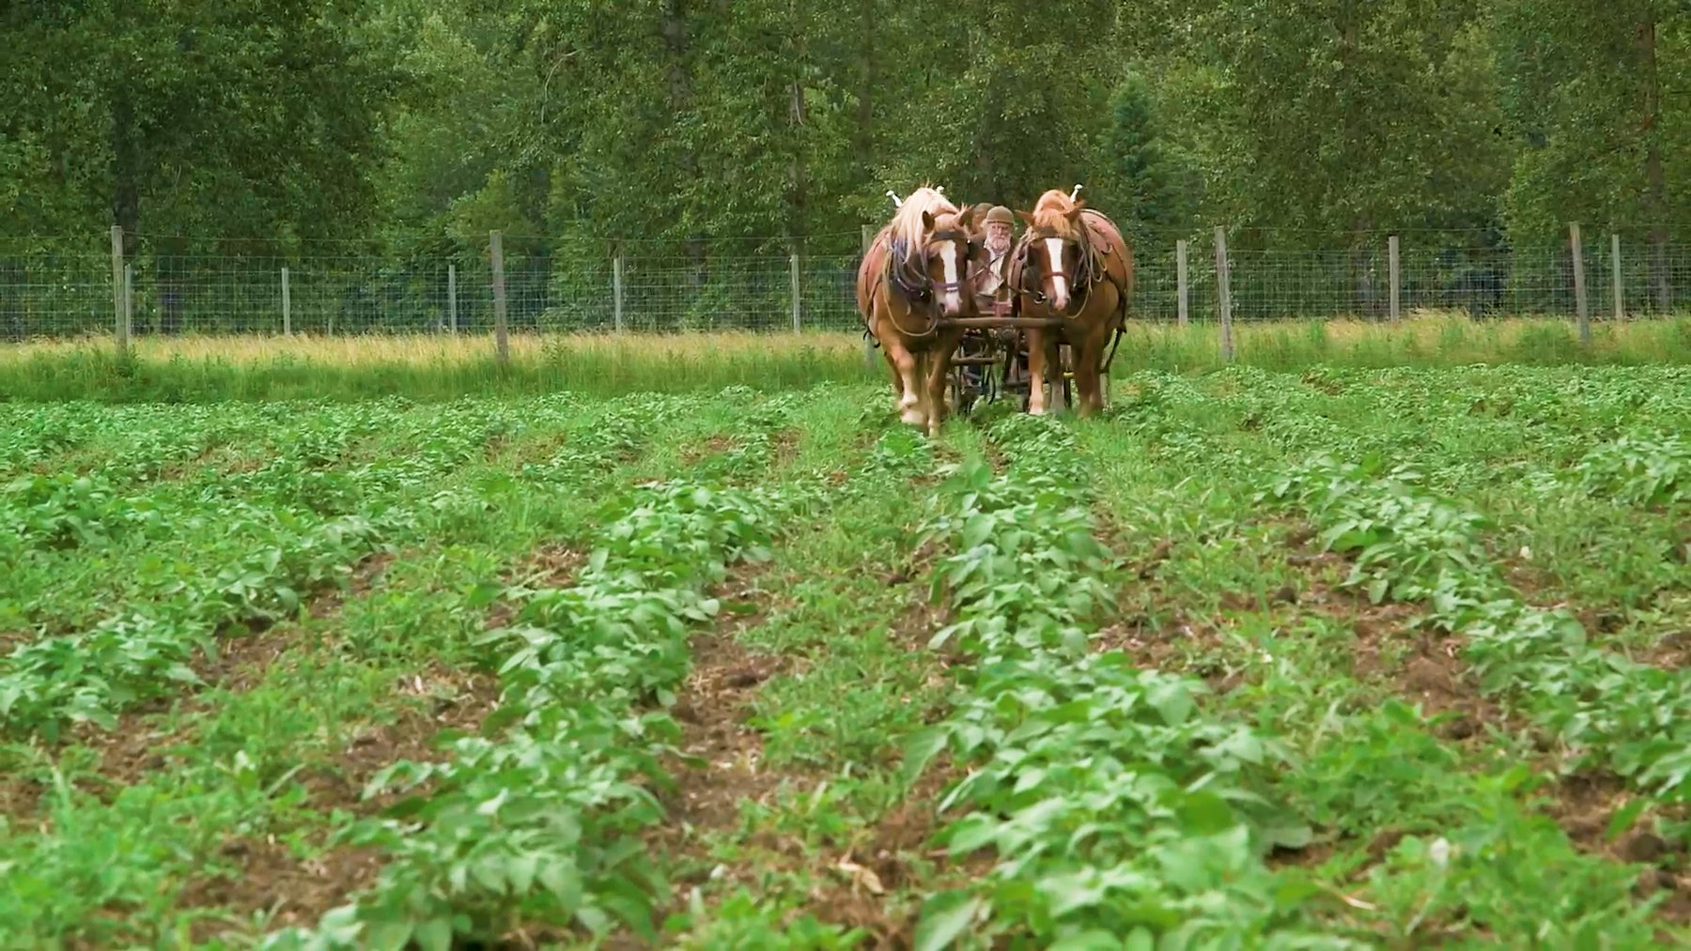
CONCEPT 01 · HOW IT WORKS
Story Purpose and Audience
1
How it works
Editing selects and orders picture and sound so a defined audience can follow an intended message and emotional arc.
2
Best used for
Turning a brief, interview or documentary theme into edit decisions.
3
Professional decision
Choose this method when its content model and edge behaviour fit the brief.
4
Quality signal
A one-sentence story intention and a shot-selection rationale are recorded.
Adobe Premiere Pro Masterclass · C387
Adobe Premiere Help
14

Slide 15
KEY CONTROLS · FAILURE MODE · PROOF
Story Purpose and Audience · control and judgement
CONTROL MAP
WATCH FOR
QUALITY PROOF
Audience; purpose; duration; channel; call to action; tone; constraints.
Choosing attractive shots that do not advance the story or meet the brief.
A one-sentence story intention and a shot-selection rationale are recorded.
Decision rule · preserve a baseline, isolate the intended change, then review at full speed and at the delivery size.
Adobe Premiere Pro Masterclass · C387
Adobe Premiere Help
15

Slide 16
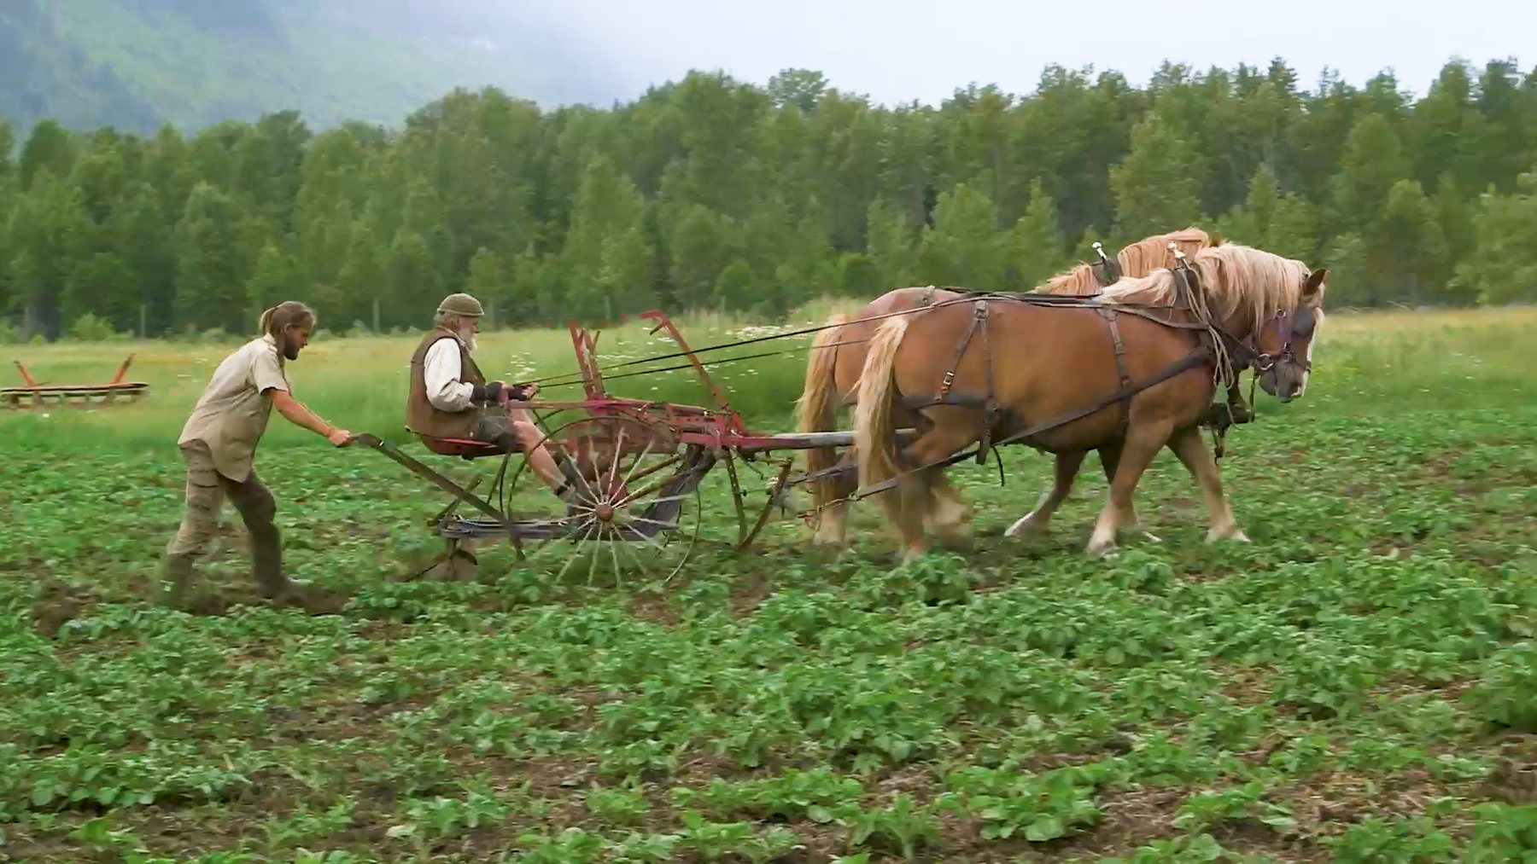
CONCEPT 02 · HOW IT WORKS
Shot Size, Angle and Visual Grammar
1
How it works
Wide, medium and close shots establish context, action and detail; angle and screen direction change meaning.
2
Best used for
Building coverage that orients viewers and supports clean cuts.
3
Professional decision
Choose this method when its content model and edge behaviour fit the brief.
4
Quality signal
The sequence preserves orientation and uses shot-size contrast intentionally.
Adobe Premiere Pro Masterclass · C387
Adobe Premiere Help
16

Slide 17
KEY CONTROLS · FAILURE MODE · PROOF
Shot Size, Angle and Visual Grammar · control and judgement
CONTROL MAP
WATCH FOR
QUALITY PROOF
Establishing shot; eyeline; headroom; lead room; 180-degree rule; match on action.
Jumping screen direction, missing context or cutting between nearly identical framings.
The sequence preserves orientation and uses shot-size contrast intentionally.
Decision rule · preserve a baseline, isolate the intended change, then review at full speed and at the delivery size.
Adobe Premiere Pro Masterclass · C387
Adobe Premiere Help
17

Slide 18

CONCEPT 03 · HOW IT WORKS
Continuity and Montage
1
How it works
Continuity hides construction across cuts; montage uses juxtaposition to compress time or create a new idea.
2
Best used for
Choosing between invisible narrative flow and expressive association.
3
Professional decision
Choose this method when its content model and edge behaviour fit the brief.
4
Quality signal
A viewer can explain place, time and action without verbal repair.
Adobe Premiere Pro Masterclass · C387
Adobe Premiere Help
18

Slide 19
KEY CONTROLS · FAILURE MODE · PROOF
Continuity and Montage · control and judgement
CONTROL MAP
WATCH FOR
QUALITY PROOF
Action match; eyeline match; cutaway; reaction; insert; temporal compression.
Continuity errors that distract, or montage shots with no conceptual relationship.
A viewer can explain place, time and action without verbal repair.
Decision rule · preserve a baseline, isolate the intended change, then review at full speed and at the delivery size.
Adobe Premiere Pro Masterclass · C387
Adobe Premiere Help
19

Slide 20
CONCEPT 04 · HOW IT WORKS
Project, Sequence and Media
How it works
Best used for
A project stores edit decisions and metadata, a sequence stores the timeline, and source media remains external.
Designing a portable, recoverable editing workspace.
Professional decision
Quality signal
Choose this method when its content model and edge behaviour fit the brief.
Project, media and export locations are documented and recoverable.
Adobe Premiere Pro Masterclass · C387
Adobe Premiere Help
20

Slide 21
KEY CONTROLS · FAILURE MODE · PROOF
Project, Sequence and Media · control and judgement
CONTROL MAP
WATCH FOR
QUALITY PROOF
Project location; scratch disks; sequence settings; media paths; cache; autosave.
Assuming a .prproj contains the media, or saving projects inside disposable cache folders.
Project, media and export locations are documented and recoverable.
Decision rule · preserve a baseline, isolate the intended change, then review at full speed and at the delivery size.
Adobe Premiere Pro Masterclass · C387
Adobe Premiere Help
21

Slide 22
CONCEPT 05 · HOW IT WORKS
Containers, Codecs and Frame Rates
How it works
Best used for
A container packages streams; codecs encode picture or sound; frame rate defines temporal sampling.
Diagnosing compatibility, playback and delivery decisions.
Professional decision
Quality signal
Choose this method when its content model and edge behaviour fit the brief.
Media properties and sequence decisions are recorded before editing.
Adobe Premiere Pro Masterclass · C387
Adobe Premiere Help
22

Slide 23
KEY CONTROLS · FAILURE MODE · PROOF
Containers, Codecs and Frame Rates · control and judgement
CONTROL MAP
WATCH FOR
QUALITY PROOF
MP4/MOV; H.264/HEVC/ProRes; CFR/VFR; 23.976/25/29.97/50/60 fps.
Treating MP4 as a codec or mixing frame rates without an explicit interpretation plan.
Media properties and sequence decisions are recorded before editing.
Decision rule · preserve a baseline, isolate the intended change, then review at full speed and at the delivery size.
Adobe Premiere Pro Masterclass · C387
Adobe Premiere Help
23

Slide 24
CONCEPT 06 · HOW IT WORKS
Import and Ingest
How it works
Best used for
Import registers source files in the project; ingest can copy, transcode or create proxies while preserving source relationships.
Starting projects from cameras, recorders, stills and shared storage.
Professional decision
Quality signal
Choose this method when its content model and edge behaviour fit the brief.
All sources appear in named bins and the verified master copy remains untouched.
Adobe Premiere Pro Masterclass · C387
Adobe Premiere Help
24

Slide 25
KEY CONTROLS · FAILURE MODE · PROOF
Import and Ingest · control and judgement
CONTROL MAP
WATCH FOR
QUALITY PROOF
Media Browser; Import mode; copy; transcode; proxy preset; checksum; naming.
Renaming or moving camera-card structures before a verified copy exists.
All sources appear in named bins and the verified master copy remains untouched.
Decision rule · preserve a baseline, isolate the intended change, then review at full speed and at the delivery size.
Adobe Premiere Pro Masterclass · C387
Adobe Premiere Help
25

Slide 26
CONCEPT 07 · HOW IT WORKS
Proxy Workflow
How it works
Best used for
Proxies are lighter alternate files attached to high-quality originals and toggled for smoother editing.
High-resolution, long-GOP or multi-camera media on constrained hardware.
Professional decision
Quality signal
Choose this method when its content model and edge behaviour fit the brief.
Proxy status is visible, playback improves and final export uses approved masters.
Adobe Premiere Pro Masterclass · C387
Adobe Premiere Help
26

Slide 27
KEY CONTROLS · FAILURE MODE · PROOF
Proxy Workflow · control and judgement
CONTROL MAP
WATCH FOR
QUALITY PROOF
Create Proxies; preset; frame size; watermark; attach; toggle; full-resolution export.
Exporting the proxies accidentally or losing source/proxy relink relationships.
Proxy status is visible, playback improves and final export uses approved masters.
Decision rule · preserve a baseline, isolate the intended change, then review at full speed and at the delivery size.
Adobe Premiere Pro Masterclass · C387
Adobe Premiere Help
27

Slide 28

CONCEPT 08 · HOW IT WORKS
Bins, Metadata and Search
1
How it works
Bins create human-readable hierarchy while metadata and search bins expose technical and editorial attributes.
2
Best used for
Large interview and B-roll libraries.
3
Professional decision
Choose this method when its content model and edge behaviour fit the brief.
4
Quality signal
A second editor can locate a requested moment quickly.
Adobe Premiere Pro Masterclass · C387
Adobe Premiere Help
28

Slide 29
KEY CONTROLS · FAILURE MODE · PROOF
Bins, Metadata and Search · control and judgement
CONTROL MAP
WATCH FOR
QUALITY PROOF
Scene; take; camera; good; description; label; search bin; icon/list/freeform view.
Deep anonymous folders, duplicate names or metadata that exists only in a separate spreadsheet.
A second editor can locate a requested moment quickly.
Decision rule · preserve a baseline, isolate the intended change, then review at full speed and at the delivery size.
Adobe Premiere Pro Masterclass · C387
Adobe Premiere Help
29

Slide 30
CONCEPT 09 · HOW IT WORKS
Offline Media and Relinking
How it works
Best used for
Premiere retains clip metadata when source files move and can reconnect them by name, path and media properties.
Portable drives, shared storage and handed-off projects.
Professional decision
Quality signal
Choose this method when its content model and edge behaviour fit the brief.
Every clip is online and spot checks match picture, duration and timecode.
Adobe Premiere Pro Masterclass · C387
Adobe Premiere Help
30

Slide 31
KEY CONTROLS · FAILURE MODE · PROOF
Offline Media and Relinking · control and judgement
CONTROL MAP
WATCH FOR
QUALITY PROOF
Link Media; Locate; relink others automatically; file extension; media start; timecode.
Relinking a same-named but different clip or breaking folder structure after approval.
Every clip is online and spot checks match picture, duration and timecode.
Decision rule · preserve a baseline, isolate the intended change, then review at full speed and at the delivery size.
Adobe Premiere Pro Masterclass · C387
Adobe Premiere Help
31

Slide 32
HANDS-ON APPLICATION · TOPIC 1
Lab 01 · Project Setup, Ingest and Proxies
Set up a recoverable project, inspect source properties, import media into bins and attach proxies.
1
2
3
4
5
Analyse
Assemble
Refine
Verify
Retain
EVIDENCE
Lab01-Working.prproj, media-property log, bin screenshot, proxy-status screenshot and verified MP4.
A documentary team has supplied mixed interview and B-roll files. The edit must remain portable and responsive on a training laptop.
Full procedure · Learner Guide / Lab 01
Adobe Premiere Pro Masterclass · C387
32

Slide 33
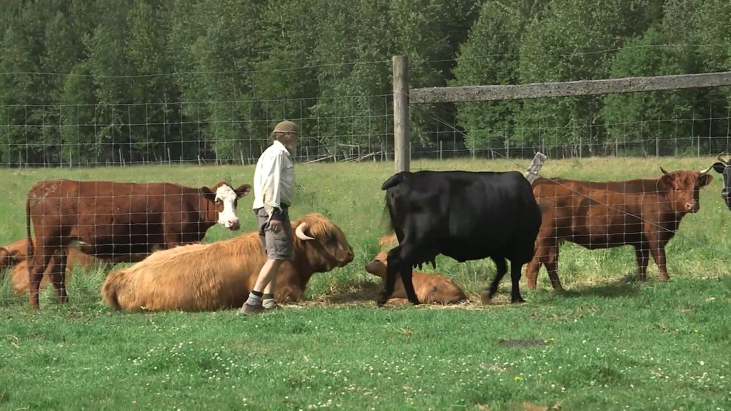
HANDS-ON APPLICATION · TOPIC 1
Lab 02 · Editing Logs, Markers and Rough-Cut Plan
Create an editing log, mark selects and assemble a clear story spine.
1
2
3
4
5
Analyse
Assemble
Refine
Verify
Retain
EVIDENCE
Lab02-Working.prproj, completed log, marker screenshot and selects-reel MP4.
A producer needs a traceable shortlist of interview ideas and supporting B-roll before the first assembly.
Full procedure · Learner Guide / Lab 02
Adobe Premiere Pro Masterclass · C387
33

Slide 34
EXPLAIN THE EDIT
Topic 1 Checkpoint
Purpose
Choice
Control
What should the audience understand or feel?
Why does this shot, sound or effect fit the brief?
Which setting most changes the result?
Failure
Proof
Next
What defect would make the edit unacceptable?
Which timecode, scope, meter or export property proves quality?
What traceable revision would improve the sequence?
Adobe Premiere Pro Masterclass · C387
34

Slide 35
02
Shot Editing
Source and Program monitors · three-point editing · track control · trim types · pacing · transitions
LO2
Adobe Premiere Pro Masterclass · C387
35

Slide 36
EDITABLE PACING CHART
Average Shot Length and Perceived Energy
READ THE CHART
Illustrative relationship, not a fixed rule: movement, audio rhythm and information density also shape pacing.
Editable native PowerPoint chart
Adobe Premiere Pro Masterclass · C387
Legacy deck · pacing principles
36

Slide 37
CONCEPT 10 · HOW IT WORKS
Source, Program and Timeline Roles
How it works
Best used for
The Source Monitor prepares individual clips; the Program Monitor shows sequence output; the Timeline holds edit relationships.
Separating source decisions from sequence review.
Professional decision
Quality signal
Choose this method when its content model and edge behaviour fit the brief.
The correct monitor and timecode are named in the editing log.
Adobe Premiere Pro Masterclass · C387
Adobe Premiere Help
37

Slide 38
KEY CONTROLS · FAILURE MODE · PROOF
Source, Program and Timeline Roles · control and judgement
CONTROL MAP
WATCH FOR
QUALITY PROOF
Playhead; In/Out; track headers; time ruler; safe margins; playback resolution.
Marking the sequence when intending to mark the source, or judging quality at low playback resolution.
The correct monitor and timecode are named in the editing log.
Decision rule · preserve a baseline, isolate the intended change, then review at full speed and at the delivery size.
Adobe Premiere Pro Masterclass · C387
Adobe Premiere Help
38

Slide 39
CONCEPT 11 · HOW IT WORKS
In, Out and Three-Point Editing
How it works
Best used for
Any three of source In, source Out, sequence In and sequence Out define an edit; Premiere calculates the fourth.
Precise duration-controlled assembly.
Professional decision
Quality signal
Choose this method when its content model and edge behaviour fit the brief.
The inserted segment starts, ends and lands at the logged timecodes.
Adobe Premiere Pro Masterclass · C387
Adobe Premiere Help
39

Slide 40
KEY CONTROLS · FAILURE MODE · PROOF
In, Out and Three-Point Editing · control and judgement
CONTROL MAP
WATCH FOR
QUALITY PROOF
I/O; clear In/Out; insert; overwrite; source duration; sequence target.
Leaving stale marks or forcing a duration that changes the wrong source boundary.
The inserted segment starts, ends and lands at the logged timecodes.
Decision rule · preserve a baseline, isolate the intended change, then review at full speed and at the delivery size.
Adobe Premiere Pro Masterclass · C387
Adobe Premiere Help
40

Slide 41
CONCEPT 12 · HOW IT WORKS
Insert vs Overwrite
How it works
Best used for
Insert opens time and ripples later clips; overwrite replaces occupied duration without changing later timing.
Choosing whether new material should move or replace downstream content.
Professional decision
Quality signal
Choose this method when its content model and edge behaviour fit the brief.
Before/after duration and displaced tracks match the editing intention.
Adobe Premiere Pro Masterclass · C387
Adobe Premiere Help
41

Slide 42
KEY CONTROLS · FAILURE MODE · PROOF
Insert vs Overwrite · control and judgement
CONTROL MAP
WATCH FOR
QUALITY PROOF
Comma/period shortcuts; source patching; track targeting; sync locks.
Using insert in a locked-duration programme or overwriting wanted content.
Before/after duration and displaced tracks match the editing intention.
Decision rule · preserve a baseline, isolate the intended change, then review at full speed and at the delivery size.
Adobe Premiere Pro Masterclass · C387
Adobe Premiere Help
42

Slide 43
CONCEPT 13 · HOW IT WORKS
Source Patching and Track Targeting
How it works
Best used for
Source patches route incoming channels; track targets determine many timeline commands and navigation operations.
Controlling where video and audio land in multi-track sequences.
Professional decision
Quality signal
Choose this method when its content model and edge behaviour fit the brief.
Imported channels land on named tracks without disturbing protected content.
Adobe Premiere Pro Masterclass · C387
Adobe Premiere Help
43

Slide 44
KEY CONTROLS · FAILURE MODE · PROOF
Source Patching and Track Targeting · control and judgement
CONTROL MAP
WATCH FOR
QUALITY PROOF
V1/A1 patches; target highlights; sync locks; linked selection.
Sending audio to the wrong track or misunderstanding target versus patch state.
Imported channels land on named tracks without disturbing protected content.
Decision rule · preserve a baseline, isolate the intended change, then review at full speed and at the delivery size.
Adobe Premiere Pro Masterclass · C387
Adobe Premiere Help
44

Slide 45
CONCEPT 14 · HOW IT WORKS
Selection, Razor and Add Edit
How it works
Best used for
Selection moves and trims clips; Razor or Add Edit creates edit points; keyboard methods reduce tool switching.
Building and restructuring rough cuts.
Professional decision
Quality signal
Choose this method when its content model and edge behaviour fit the brief.
Edit points are deliberate and no orphaned frames or audio pieces remain.
Adobe Premiere Pro Masterclass · C387
Adobe Premiere Help
45

Slide 46
KEY CONTROLS · FAILURE MODE · PROOF
Selection, Razor and Add Edit · control and judgement
CONTROL MAP
WATCH FOR
QUALITY PROOF
Selection; Razor; Cmd/Ctrl+K; linked selection; snapping; track selection.
Cutting every enabled track or separating linked audio unintentionally.
Edit points are deliberate and no orphaned frames or audio pieces remain.
Decision rule · preserve a baseline, isolate the intended change, then review at full speed and at the delivery size.
Adobe Premiere Pro Masterclass · C387
Adobe Premiere Help
46

Slide 47
CONCEPT 15 · HOW IT WORKS
Ripple and Rolling Trims
How it works
Best used for
Ripple changes one side and sequence duration; Rolling moves the cut while preserving combined duration.
Tightening pauses or shifting emphasis between adjacent shots.
Professional decision
Quality signal
Choose this method when its content model and edge behaviour fit the brief.
The intended timing changes and downstream sync remains verified.
Adobe Premiere Pro Masterclass · C387
Adobe Premiere Help
47

Slide 48
KEY CONTROLS · FAILURE MODE · PROOF
Ripple and Rolling Trims · control and judgement
CONTROL MAP
WATCH FOR
QUALITY PROOF
Ripple tool; Rolling tool; Q/W trims; trim mode; sync locks.
Breaking sync or rippling a locked timing milestone.
The intended timing changes and downstream sync remains verified.
Decision rule · preserve a baseline, isolate the intended change, then review at full speed and at the delivery size.
Adobe Premiere Pro Masterclass · C387
Adobe Premiere Help
48

Slide 49
CONCEPT 16 · HOW IT WORKS
Slip and Slide Edits
How it works
Best used for
Slip changes a clip's source In/Out while holding timeline position; Slide moves the clip while adjusting its neighbours.
Refining content without rebuilding sequence timing.
Professional decision
Quality signal
Choose this method when its content model and edge behaviour fit the brief.
Sequence duration is unchanged and the chosen action frames improve continuity.
Adobe Premiere Pro Masterclass · C387
Adobe Premiere Help
49

Slide 50
KEY CONTROLS · FAILURE MODE · PROOF
Slip and Slide Edits · control and judgement
CONTROL MAP
WATCH FOR
QUALITY PROOF
Slip tool; Slide tool; four-up display; handles; neighbouring coverage.
Insufficient handles or changing the wrong narrative beat.
Sequence duration is unchanged and the chosen action frames improve continuity.
Decision rule · preserve a baseline, isolate the intended change, then review at full speed and at the delivery size.
Adobe Premiere Pro Masterclass · C387
Adobe Premiere Help
50

Slide 51
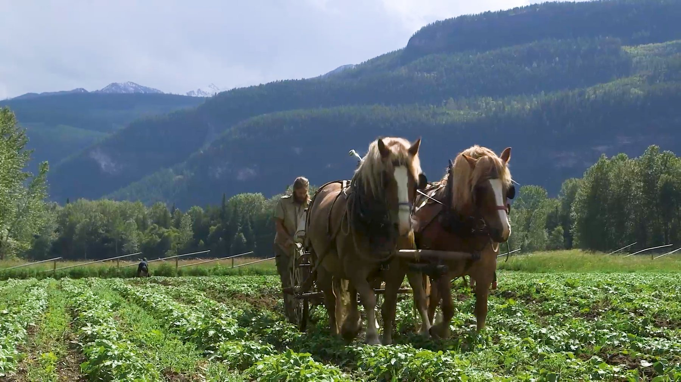
CONCEPT 17 · HOW IT WORKS
Pacing and Shot Duration
1
How it works
Shot duration, movement, audio rhythm and information density shape perceived energy and comprehension.
2
Best used for
Matching fast action, reflective interviews and instructional content.
3
Professional decision
Choose this method when its content model and edge behaviour fit the brief.
4
Quality signal
A pacing log links key cuts to story beats and audience response.
Adobe Premiere Pro Masterclass · C387
Adobe Premiere Help
51

Slide 52
KEY CONTROLS · FAILURE MODE · PROOF
Pacing and Shot Duration · control and judgement
CONTROL MAP
WATCH FOR
QUALITY PROOF
Average shot length; pause; reaction; beat; J-cut/L-cut; music phrase.
Uniform shot duration or speed used without story justification.
A pacing log links key cuts to story beats and audience response.
Decision rule · preserve a baseline, isolate the intended change, then review at full speed and at the delivery size.
Adobe Premiere Pro Masterclass · C387
Adobe Premiere Help
52

Slide 53

CONCEPT 18 · HOW IT WORKS
Transitions and Handles
1
How it works
A transition overlaps outgoing and incoming media, requiring unused source frames called handles.
2
Best used for
Signalling time, place, memory or a deliberate stylistic change.
3
Professional decision
Choose this method when its content model and edge behaviour fit the brief.
4
Quality signal
Most edits work as cuts; selected transitions have a documented narrative purpose.
Adobe Premiere Pro Masterclass · C387
Adobe Premiere Help
53

Slide 54
KEY CONTROLS · FAILURE MODE · PROOF
Transitions and Handles · control and judgement
CONTROL MAP
WATCH FOR
QUALITY PROOF
Cut; dissolve; dip; wipe; duration; alignment; handles; default transition.
Using transitions to hide weak shot choice, or repeated decorative effects.
Most edits work as cuts; selected transitions have a documented narrative purpose.
Decision rule · preserve a baseline, isolate the intended change, then review at full speed and at the delivery size.
Adobe Premiere Pro Masterclass · C387
Adobe Premiere Help
54

Slide 55
CONCEPT 19 · HOW IT WORKS
J-Cuts, L-Cuts and Continuity Bridges
How it works
Best used for
A J-cut lets incoming audio lead picture; an L-cut lets outgoing audio continue under the next shot.
Smoother dialogue, interview B-roll and scene connections.
Professional decision
Quality signal
Choose this method when its content model and edge behaviour fit the brief.
Audio bridges hide picture edits while speech remains natural.
Adobe Premiere Pro Masterclass · C387
Adobe Premiere Help
55

Slide 56
KEY CONTROLS · FAILURE MODE · PROOF
J-Cuts, L-Cuts and Continuity Bridges · control and judgement
CONTROL MAP
WATCH FOR
QUALITY PROOF
Linked selection; rolling audio; constant power; room tone; cutaway.
Audible discontinuities, exposed gaps or dialogue cut mid-phoneme.
Audio bridges hide picture edits while speech remains natural.
Decision rule · preserve a baseline, isolate the intended change, then review at full speed and at the delivery size.
Adobe Premiere Pro Masterclass · C387
Adobe Premiere Help
56

Slide 57
HANDS-ON APPLICATION · TOPIC 2
Lab 03 · Three-Point Editing, Trims and Pacing
Use three-point edits and multiple trim types to produce a deliberate 25–35 second sequence.
1
2
3
4
5
Analyse
Assemble
Refine
Verify
Retain
EVIDENCE
Lab03-Working.prproj, trim-decision log and paced MP4.
An interview section feels slow and repetitive. The director wants a concise version that keeps the speaker's meaning.
Full procedure · Learner Guide / Lab 03
Adobe Premiere Pro Masterclass · C387
57

Slide 58
HANDS-ON APPLICATION · TOPIC 2
Lab 04 · Continuity, Cutaways and Transitions
Build a continuity sequence and use a transition only where it communicates story meaning.
1
2
3
4
5
Analyse
Assemble
Refine
Verify
Retain
EVIDENCE
Lab04-Working.prproj, continuity map, transition rationale and montage MP4.
A farm-work montage needs clear geography and one motivated passage of time without decorative transition overload.
Full procedure · Learner Guide / Lab 04
Adobe Premiere Pro Masterclass · C387
58

Slide 59
EXPLAIN THE EDIT
Topic 2 Checkpoint
Purpose
Choice
Control
What should the audience understand or feel?
Why does this shot, sound or effect fit the brief?
Which setting most changes the result?
Failure
Proof
Next
What defect would make the edit unacceptable?
Which timecode, scope, meter or export property proves quality?
What traceable revision would improve the sequence?
Adobe Premiere Pro Masterclass · C387
59

Slide 60
03
Audio and Graphics Editing
Gain and volume · keyframes · repair · music · sync · stills · graphics · effects · masks
LO3
Adobe Premiere Pro Masterclass · C387
60

Slide 61
EDITABLE MIXING CHART
Dialogue-to-Music Balance
READ THE CHART
Illustrative relative values encourage hierarchy. Use meters and listening tests; do not treat these numbers as loudness standards.
Editable native PowerPoint chart
Adobe Premiere Pro Masterclass · C387
Adobe Premiere Help · audio
61

Slide 62
CONCEPT 20 · HOW IT WORKS
Gain, Volume and Signal Flow
How it works
Best used for
Gain changes clip input level; volume and track controls change level later in the sequence signal path.
Normalising inconsistent recordings before mixing.
Professional decision
Quality signal
Choose this method when its content model and edge behaviour fit the brief.
Dialogue is consistent, unclipped and leaves suitable headroom.
Adobe Premiere Pro Masterclass · C387
Adobe Premiere Help
62

Slide 63
KEY CONTROLS · FAILURE MODE · PROOF
Gain, Volume and Signal Flow · control and judgement
CONTROL MAP
WATCH FOR
QUALITY PROOF
Audio Gain; peak amplitude; normalize; clip volume; track fader; meters.
Boosting noisy audio excessively or confusing gain with track automation.
Dialogue is consistent, unclipped and leaves suitable headroom.
Decision rule · preserve a baseline, isolate the intended change, then review at full speed and at the delivery size.
Adobe Premiere Pro Masterclass · C387
Adobe Premiere Help
63

Slide 64
CONCEPT 21 · HOW IT WORKS
Meters, Headroom and Clipping
How it works
Best used for
Digital meters show sample peaks; 0 dBFS is the ceiling and clipping cannot be repaired by lowering volume later.
Preventing distortion and balancing dialogue, music and effects.
Professional decision
Quality signal
Choose this method when its content model and edge behaviour fit the brief.
Full-programme playback shows stable, unclipped levels.
Adobe Premiere Pro Masterclass · C387
Adobe Premiere Help
64

Slide 65
KEY CONTROLS · FAILURE MODE · PROOF
Meters, Headroom and Clipping · control and judgement
CONTROL MAP
WATCH FOR
QUALITY PROOF
Peak meter; dBFS; true-peak awareness; channel layout; mute/solo.
Mixing by ear alone or allowing red clip indicators to persist.
Full-programme playback shows stable, unclipped levels.
Decision rule · preserve a baseline, isolate the intended change, then review at full speed and at the delivery size.
Adobe Premiere Pro Masterclass · C387
Adobe Premiere Help
65

Slide 66
CONCEPT 22 · HOW IT WORKS
Clip Keyframes and Automation
How it works
Best used for
Keyframes store parameter values over time and interpolate volume, pan, opacity, motion and effects.
Fades, ducking, emphasis and animated properties.
Professional decision
Quality signal
Choose this method when its content model and edge behaviour fit the brief.
The envelope is smooth and parameter changes occur at intended story beats.
Adobe Premiere Pro Masterclass · C387
Adobe Premiere Help
66

Slide 67
KEY CONTROLS · FAILURE MODE · PROOF
Clip Keyframes and Automation · control and judgement
CONTROL MAP
WATCH FOR
QUALITY PROOF
Add/remove keyframe; Bezier/linear; temporal interpolation; rubber band; automation mode.
Too few keyframes causing abrupt change or too many creating noisy automation.
The envelope is smooth and parameter changes occur at intended story beats.
Decision rule · preserve a baseline, isolate the intended change, then review at full speed and at the delivery size.
Adobe Premiere Pro Masterclass · C387
Adobe Premiere Help
67

Slide 68
CONCEPT 23 · HOW IT WORKS
Dialogue Repair and Essential Sound
1
How it works
Dialogue tools classify clips and provide repair, clarity and loudness controls around common speech problems.
2
Best used for
Noise, hum, rumble, sibilance and inconsistent interview recordings.
3
Professional decision
Choose this method when its content model and edge behaviour fit the brief.
4
Quality signal
A/B review improves intelligibility without audible artefacts.
Adobe Premiere Pro Masterclass · C387
Adobe Premiere Help
68

Slide 69
KEY CONTROLS · FAILURE MODE · PROOF
Dialogue Repair and Essential Sound · control and judgement
CONTROL MAP
WATCH FOR
QUALITY PROOF
Dialogue tag; Reduce Noise; Reduce Rumble; DeHum; DeEss; Enhance Speech; loudness.
Over-processing that creates metallic or phasey speech.
A/B review improves intelligibility without audible artefacts.
Decision rule · preserve a baseline, isolate the intended change, then review at full speed and at the delivery size.
Adobe Premiere Pro Masterclass · C387
Adobe Premiere Help
69

Slide 70
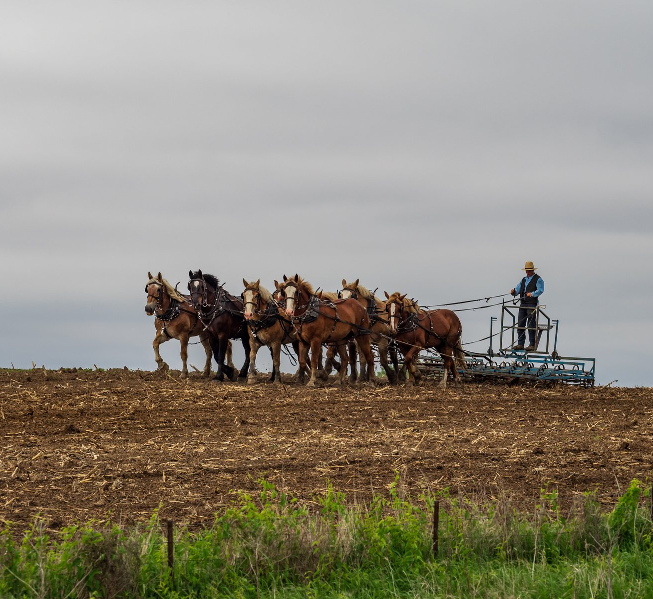
CONCEPT 24 · HOW IT WORKS
Music Editing, Remix and Fades
1
How it works
Music edits can follow phrase boundaries; Remix changes duration algorithmically; fades and ducking protect dialogue.
2
Best used for
Fitting music to locked duration and shaping scene energy.
3
Professional decision
Choose this method when its content model and edge behaviour fit the brief.
4
Quality signal
The music ends musically and dialogue remains clear.
Adobe Premiere Pro Masterclass · C387
Adobe Premiere Help
70

Slide 71
KEY CONTROLS · FAILURE MODE · PROOF
Music Editing, Remix and Fades · control and judgement
CONTROL MAP
WATCH FOR
QUALITY PROOF
Waveform; beat; remix duration; crossfade; keyframes; Essential Sound ducking.
Cutting across a musical phrase or masking speech with midrange energy.
The music ends musically and dialogue remains clear.
Decision rule · preserve a baseline, isolate the intended change, then review at full speed and at the delivery size.
Adobe Premiere Pro Masterclass · C387
Adobe Premiere Help
71

Slide 72
CONCEPT 25 · HOW IT WORKS
Synchronising Audio and Video
How it works
Best used for
Premiere can synchronise by timecode, markers or matching waveforms; manual slips handle residual offsets.
Dual-system sound and multi-camera interviews.
Professional decision
Quality signal
Choose this method when its content model and edge behaviour fit the brief.
Lip sync and transient checks match at multiple points.
Adobe Premiere Pro Masterclass · C387
Adobe Premiere Help
72

Slide 73
KEY CONTROLS · FAILURE MODE · PROOF
Synchronising Audio and Video · control and judgement
CONTROL MAP
WATCH FOR
QUALITY PROOF
Synchronize; merge clips; timecode; waveform; slate; linked selection.
Syncing noisy reference audio blindly or deleting production audio before verification.
Lip sync and transient checks match at multiple points.
Decision rule · preserve a baseline, isolate the intended change, then review at full speed and at the delivery size.
Adobe Premiere Pro Masterclass · C387
Adobe Premiere Help
73

Slide 74

CONCEPT 26 · HOW IT WORKS
Still Images and Motion
1
How it works
Still images occupy time like clips; Motion properties and keyframes create reframing and pan/zoom movement.
2
Best used for
Photographs, documents, maps and title cards.
3
Professional decision
Choose this method when its content model and edge behaviour fit the brief.
4
Quality signal
Image detail holds at delivery size and motion supports the narration.
Adobe Premiere Pro Masterclass · C387
Adobe Premiere Help
74

Slide 75
KEY CONTROLS · FAILURE MODE · PROOF
Still Images and Motion · control and judgement
CONTROL MAP
WATCH FOR
QUALITY PROOF
Default still duration; Set/Scale to Frame Size; Position; Scale; anchor; keyframes.
Scaling beyond available pixels or creating distracting constant motion.
Image detail holds at delivery size and motion supports the narration.
Decision rule · preserve a baseline, isolate the intended change, then review at full speed and at the delivery size.
Adobe Premiere Pro Masterclass · C387
Adobe Premiere Help
75

Slide 76
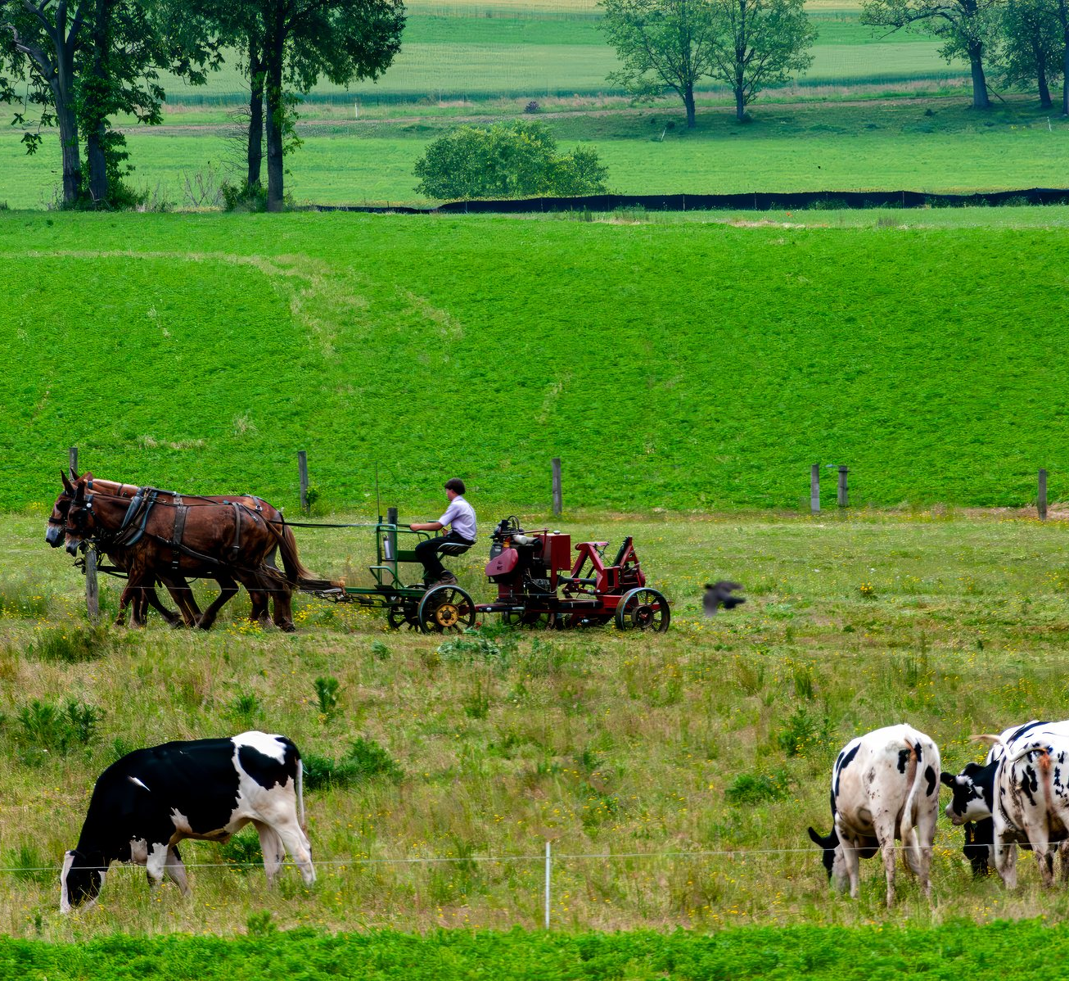
CONCEPT 27 · HOW IT WORKS
Graphics and Lower Thirds
1
How it works
Text and vector shapes remain editable graphics clips whose properties can be styled and animated.
2
Best used for
Names, roles, locations, chapter labels and calls to action.
3
Professional decision
Choose this method when its content model and edge behaviour fit the brief.
4
Quality signal
The lower third reads at playback speed and survives safe-area review.
Adobe Premiere Pro Masterclass · C387
Adobe Premiere Help
76

Slide 77
KEY CONTROLS · FAILURE MODE · PROOF
Graphics and Lower Thirds · control and judgement
CONTROL MAP
WATCH FOR
QUALITY PROOF
Type tool; Properties; alignment; safe margins; responsive design; styles.
Low contrast, tiny type, inconsistent margins or covering important picture content.
The lower third reads at playback speed and survives safe-area review.
Decision rule · preserve a baseline, isolate the intended change, then review at full speed and at the delivery size.
Adobe Premiere Pro Masterclass · C387
Adobe Premiere Help
77

Slide 78
CONCEPT 28 · HOW IT WORKS
Effects and Adjustment Layers
How it works
Best used for
Clip effects affect one item; adjustment layers apply effects to the composite beneath and preserve shared control.
Consistent looks, effects stacks and reusable treatments.
Professional decision
Quality signal
Choose this method when its content model and edge behaviour fit the brief.
Effect order is documented and an A/B toggle proves the intended contribution.
Adobe Premiere Pro Masterclass · C387
Adobe Premiere Help
78

Slide 79
KEY CONTROLS · FAILURE MODE · PROOF
Effects and Adjustment Layers · control and judgement
CONTROL MAP
WATCH FOR
QUALITY PROOF
Effects panel; Effect Controls; order; enable/disable; adjustment layer; render bar.
Duplicating inconsistent settings or stacking effects without isolating the cause.
Effect order is documented and an A/B toggle proves the intended contribution.
Decision rule · preserve a baseline, isolate the intended change, then review at full speed and at the delivery size.
Adobe Premiere Pro Masterclass · C387
Adobe Premiere Help
79

Slide 80
CONCEPT 29 · HOW IT WORKS
Masks, Tracking and Stabilisation
1
How it works
Effect masks limit treatment; tracking follows motion; Warp Stabilizer analyses camera motion and reframes edges.
2
Best used for
Privacy blur, selective correction and unwanted camera shake.
3
Professional decision
Choose this method when its content model and edge behaviour fit the brief.
4
Quality signal
The mask follows the subject and stabilisation does not distort important geometry.
Adobe Premiere Pro Masterclass · C387
Adobe Premiere Help
80

Slide 81
KEY CONTROLS · FAILURE MODE · PROOF
Masks, Tracking and Stabilisation · control and judgement
CONTROL MAP
WATCH FOR
QUALITY PROOF
Ellipse/pen mask; feather; expansion; track; stabilisation method; smoothness; crop.
Tracking poor contrast, masking the wrong object or accepting heavy warping.
The mask follows the subject and stabilisation does not distort important geometry.
Decision rule · preserve a baseline, isolate the intended change, then review at full speed and at the delivery size.
Adobe Premiere Pro Masterclass · C387
Adobe Premiere Help
81

Slide 82
HANDS-ON APPLICATION · TOPIC 3
Lab 05 · Dialogue Repair, Music and Keyframes
Repair dialogue, balance music and create smooth level automation.
1
2
3
4
5
Analyse
Assemble
Refine
Verify
Retain
EVIDENCE
Lab05-Working.prproj, before/after level notes, keyframe screenshot and mixed MP4.
The interview is uneven and contains background noise; music must support the scene without masking speech.
Full procedure · Learner Guide / Lab 05
Adobe Premiere Pro Masterclass · C387
82

Slide 83
HANDS-ON APPLICATION · TOPIC 3
Lab 06 · Stills, Graphics and Adjustment Effects
Animate a still, build a readable lower third and apply a shared effect non-destructively.
1
2
3
4
5
Analyse
Assemble
Refine
Verify
Retain
EVIDENCE
Lab06-Working.prproj, keyframe screenshot, safe-margin screenshot and graphics MP4.
A short documentary section needs a still photograph, a lower third and a restrained shared treatment.
Full procedure · Learner Guide / Lab 06
Adobe Premiere Pro Masterclass · C387
83

Slide 84
HANDS-ON APPLICATION · TOPIC 3
Lab 07 · Masks, Tracking and Visual Clean-up
Stabilise the clip and track a feathered effect mask to clean a local imperfection.
1
2
3
4
5
Analyse
Assemble
Refine
Verify
Retain
EVIDENCE
Lab07-Working.prproj, stabilisation/mask settings, A/B notes and cleaned MP4.
An outdoor clip contains camera shake and a distracting region that must be reduced without damaging the subject.
Full procedure · Learner Guide / Lab 07
Adobe Premiere Pro Masterclass · C387
84

Slide 85
EXPLAIN THE EDIT
Topic 3 Checkpoint
Purpose
Choice
Control
What should the audience understand or feel?
Why does this shot, sound or effect fit the brief?
Which setting most changes the result?
Failure
Proof
Next
What defect would make the edit unacceptable?
Which timecode, scope, meter or export property proves quality?
What traceable revision would improve the sequence?
Adobe Premiere Pro Masterclass · C387
85

Slide 86
04
Clip and Colour Editing
Speed · time remapping · colour correction · scopes · matching · review and collaboration
LO4
Adobe Premiere Pro Masterclass · C387
86

Slide 87
EDITABLE QUALITY CHART
Shot-Matching Review Score
READ THE CHART
Use scopes and visual review to improve consistency. The values are an editable example rubric, not measured source data.
Editable native PowerPoint chart
Adobe Premiere Pro Masterclass · C387
Adobe Premiere Help · colour correction
87

Slide 88
CONCEPT 30 · HOW IT WORKS
Speed and Duration
1
How it works
Speed percentage and duration are inversely related; frame blending or optical methods create intermediate frames.
2
Best used for
Slow motion, time compression and fitting action to timing.
3
Professional decision
Choose this method when its content model and edge behaviour fit the brief.
4
Quality signal
Motion is visually acceptable and final duration matches the brief.
Adobe Premiere Pro Masterclass · C387
Adobe Premiere Help
88

Slide 89
KEY CONTROLS · FAILURE MODE · PROOF
Speed and Duration · control and judgement
CONTROL MAP
WATCH FOR
QUALITY PROOF
Speed/Duration; reverse; ripple trailing clips; frame sampling; frame blending; optical flow.
Using optical flow on occlusions or violating production frame-rate requirements.
Motion is visually acceptable and final duration matches the brief.
Decision rule · preserve a baseline, isolate the intended change, then review at full speed and at the delivery size.
Adobe Premiere Pro Masterclass · C387
Adobe Premiere Help
89

Slide 90
CONCEPT 31 · HOW IT WORKS
Rate Stretch and Time Remapping
How it works
Best used for
Rate Stretch fits a clip to timeline duration; Time Remapping changes speed over time with keyframes and ramps.
Variable-speed emphasis and precise gap filling.
Professional decision
Quality signal
Choose this method when its content model and edge behaviour fit the brief.
The ramp enters and exits smoothly at meaningful action points.
Adobe Premiere Pro Masterclass · C387
Adobe Premiere Help
90

Slide 91
KEY CONTROLS · FAILURE MODE · PROOF
Rate Stretch and Time Remapping · control and judgement
CONTROL MAP
WATCH FOR
QUALITY PROOF
Rate Stretch tool; speed keyframes; ramp handles; time interpolation.
Unmotivated ramps, audio pitch artefacts or action changing too abruptly.
The ramp enters and exits smoothly at meaningful action points.
Decision rule · preserve a baseline, isolate the intended change, then review at full speed and at the delivery size.
Adobe Premiere Pro Masterclass · C387
Adobe Premiere Help
91

Slide 92
CONCEPT 32 · HOW IT WORKS
Correction vs Grading
How it works
Best used for
Correction neutralises technical differences; grading applies an intentional creative look after correction.
Matching cameras before establishing visual style.
Professional decision
Quality signal
Choose this method when its content model and edge behaviour fit the brief.
Shots match first, then the approved grade remains consistent.
Adobe Premiere Pro Masterclass · C387
Adobe Premiere Help
92

Slide 93
KEY CONTROLS · FAILURE MODE · PROOF
Correction vs Grading · control and judgement
CONTROL MAP
WATCH FOR
QUALITY PROOF
White balance; exposure; contrast; saturation; look; bypass; order.
Using a LUT as repair or grading inconsistent sources before matching.
Shots match first, then the approved grade remains consistent.
Decision rule · preserve a baseline, isolate the intended change, then review at full speed and at the delivery size.
Adobe Premiere Pro Masterclass · C387
Adobe Premiere Help
93

Slide 94

CONCEPT 33 · HOW IT WORKS
Video Scopes
1
How it works
Waveform displays signal level by horizontal position; parade separates RGB channels; vectorscope shows hue and saturation.
2
Best used for
Objective exposure, balance, skin-tone and legal-range review.
3
Professional decision
Choose this method when its content model and edge behaviour fit the brief.
4
Quality signal
Scope captures and visual review support each correction decision.
Adobe Premiere Pro Masterclass · C387
Adobe Premiere Help
94

Slide 95
KEY CONTROLS · FAILURE MODE · PROOF
Video Scopes · control and judgement
CONTROL MAP
WATCH FOR
QUALITY PROOF
Luma waveform; RGB parade; vectorscope; scale; clipping; reference frame.
Trusting an uncalibrated display alone or reading scopes without scene context.
Scope captures and visual review support each correction decision.
Decision rule · preserve a baseline, isolate the intended change, then review at full speed and at the delivery size.
Adobe Premiere Pro Masterclass · C387
Adobe Premiere Help
95

Slide 96
CONCEPT 34 · HOW IT WORKS
White Balance and Exposure
How it works
Best used for
Temperature/tint and tonal controls neutralise casts and place key picture regions in usable ranges.
Mixed interviews, outdoor shifts and camera mismatch.
Professional decision
Quality signal
Choose this method when its content model and edge behaviour fit the brief.
Neutral references and important skin/detail areas remain plausible.
Adobe Premiere Pro Masterclass · C387
Adobe Premiere Help
96

Slide 97
KEY CONTROLS · FAILURE MODE · PROOF
White Balance and Exposure · control and judgement
CONTROL MAP
WATCH FOR
QUALITY PROOF
Eyedropper; temperature; tint; exposure; highlights; shadows; whites; blacks.
Forcing neutral balance in intentionally warm/cool scenes or clipping highlights.
Neutral references and important skin/detail areas remain plausible.
Decision rule · preserve a baseline, isolate the intended change, then review at full speed and at the delivery size.
Adobe Premiere Pro Masterclass · C387
Adobe Premiere Help
97

Slide 98
CONCEPT 35 · HOW IT WORKS
Curves and Colour Wheels
How it works
Best used for
Curves reshape tonal relationships; wheels move shadows, midtones and highlights toward chosen colour vectors.
Targeted contrast, cast repair and controlled creative shaping.
Professional decision
Quality signal
Choose this method when its content model and edge behaviour fit the brief.
Before/after scopes show controlled change without new clipping.
Adobe Premiere Pro Masterclass · C387
Adobe Premiere Help
98

Slide 99
KEY CONTROLS · FAILURE MODE · PROOF
Curves and Colour Wheels · control and judgement
CONTROL MAP
WATCH FOR
QUALITY PROOF
RGB curves; hue/saturation curves; shadow/midtone/highlight wheels; luma vs chroma.
Crossing channels aggressively or creating banding and unnatural skin.
Before/after scopes show controlled change without new clipping.
Decision rule · preserve a baseline, isolate the intended change, then review at full speed and at the delivery size.
Adobe Premiere Pro Masterclass · C387
Adobe Premiere Help
99

Slide 100
CONCEPT 36 · HOW IT WORKS
Shot Matching and Comparison View
1
How it works
Comparison View places a reference beside the current shot so visual and automatic matching can be evaluated.
2
Best used for
Interviews, multi-camera scenes and sequences under one lighting condition.
3
Professional decision
Choose this method when its content model and edge behaviour fit the brief.
4
Quality signal
Adjacent shots cut without distracting shifts in exposure or colour.
Adobe Premiere Pro Masterclass · C387
Adobe Premiere Help
100

Slide 101
KEY CONTROLS · FAILURE MODE · PROOF
Shot Matching and Comparison View · control and judgement
CONTROL MAP
WATCH FOR
QUALITY PROOF
Reference frame; current frame; face detection; colour wheels; shot match; wipe.
Matching to an unrepresentative frame or accepting automatic results without review.
Adjacent shots cut without distracting shifts in exposure or colour.
Decision rule · preserve a baseline, isolate the intended change, then review at full speed and at the delivery size.
Adobe Premiere Pro Masterclass · C387
Adobe Premiere Help
101

Slide 102
CONCEPT 37 · HOW IT WORKS
Collaborative Review and Change Control
How it works
Best used for
Timecoded comments, sequence versions and change logs make creative decisions traceable across production roles.
Director, producer, editor and client review cycles.
Professional decision
Quality signal
Choose this method when its content model and edge behaviour fit the brief.
Every accepted change links to a comment, version and verifier.
Adobe Premiere Pro Masterclass · C387
Adobe Premiere Help
102

Slide 103
KEY CONTROLS · FAILURE MODE · PROOF
Collaborative Review and Change Control · control and judgement
CONTROL MAP
WATCH FOR
QUALITY PROOF
Version name; locked review export; timecode burn-in; comment status; change log.
Overwriting approved versions or implementing ambiguous feedback without confirmation.
Every accepted change links to a comment, version and verifier.
Decision rule · preserve a baseline, isolate the intended change, then review at full speed and at the delivery size.
Adobe Premiere Pro Masterclass · C387
Adobe Premiere Help
103

Slide 104
HANDS-ON APPLICATION · TOPIC 4
Lab 08 · Speed, Duration and Time Remapping
Create constant and variable speed treatments and verify motion quality.
1
2
3
4
5
Analyse
Assemble
Refine
Verify
Retain
EVIDENCE
Lab08-Working.prproj, three treatment variants, interpolation comparison and MP4.
A farm-action montage must compress time while preserving one moment of emphasis and meeting a fixed duration.
Full procedure · Learner Guide / Lab 08
Adobe Premiere Pro Masterclass · C387
104

Slide 105
HANDS-ON APPLICATION · TOPIC 4
Lab 09 · Colour Correction, Shot Matching and Review
Correct exposure and white balance with scopes, match shots and record review changes.
1
2
3
4
5
Analyse
Assemble
Refine
Verify
Retain
EVIDENCE
Lab09-Working.prproj, before/after scopes, review v01/v02, comment log and final MP4.
Two shots recorded under different conditions must cut together naturally before a subtle approved grade is applied.
Full procedure · Learner Guide / Lab 09
Adobe Premiere Pro Masterclass · C387
105

Slide 106
EXPLAIN THE EDIT
Topic 4 Checkpoint
Purpose
Choice
Control
What should the audience understand or feel?
Why does this shot, sound or effect fit the brief?
Which setting most changes the result?
Failure
Proof
Next
What defect would make the edit unacceptable?
Which timecode, scope, meter or export property proves quality?
What traceable revision would improve the sequence?
Adobe Premiere Pro Masterclass · C387
106

Slide 107
05
Final Touch-up and Delivery
Titles · captions · reframing · quality control · export · archive · production hand-off
LO5
Adobe Premiere Pro Masterclass · C387
107

Slide 108
EDITABLE EXPORT CHART
Bitrate and Approximate 60-Second File Size
READ THE CHART
Approximation: file size ≈ bitrate × duration ÷ 8. Audio and container overhead add a little more.
Editable native PowerPoint chart
Adobe Premiere Pro Masterclass · C387
Adobe Premiere Help · export settings
108

Slide 109
EDITABLE QUALITY CHART
Final QC Weighting
READ THE CHART
A polished picture is not sufficient: story, sound, accessibility and technical delivery all contribute to approval.
Editable native PowerPoint chart
Adobe Premiere Pro Masterclass · C387
Course quality-control rubric
109

Slide 110
CONCEPT 38 · HOW IT WORKS
Text Hierarchy and Safe Placement
How it works
Best used for
Title size, weight, spacing and placement establish reading order while safe margins protect delivery visibility.
Openers, lower thirds, end cards and instructional labels.
Professional decision
Quality signal
Choose this method when its content model and edge behaviour fit the brief.
Text passes contrast, spelling, safe-area and playback-duration checks.
Adobe Premiere Pro Masterclass · C387
Adobe Premiere Help
110

Slide 111
KEY CONTROLS · FAILURE MODE · PROOF
Text Hierarchy and Safe Placement · control and judgement
CONTROL MAP
WATCH FOR
QUALITY PROOF
Font; size; leading; tracking; alignment; safe margins; duration; contrast.
Too much text, weak hierarchy or appearing for too little reading time.
Text passes contrast, spelling, safe-area and playback-duration checks.
Decision rule · preserve a baseline, isolate the intended change, then review at full speed and at the delivery size.
Adobe Premiere Pro Masterclass · C387
Adobe Premiere Help
111

Slide 112

CONCEPT 39 · HOW IT WORKS
Captions and Accessibility
1
How it works
Caption tracks align text to speech and can be styled, burned in, embedded or exported as sidecar files.
2
Best used for
Accessible dialogue, multilingual delivery and silent autoplay.
3
Professional decision
Choose this method when its content model and edge behaviour fit the brief.
4
Quality signal
Captions match speech, identify speakers where needed and pass a full read-through.
Adobe Premiere Pro Masterclass · C387
Adobe Premiere Help
112

Slide 113
KEY CONTROLS · FAILURE MODE · PROOF
Captions and Accessibility · control and judgement
CONTROL MAP
WATCH FOR
QUALITY PROOF
Transcribe; speaker names; caption creation; track style; line length; timing; SRT.
Uncorrected transcription, poor line breaks or captions covering essential visuals.
Captions match speech, identify speakers where needed and pass a full read-through.
Decision rule · preserve a baseline, isolate the intended change, then review at full speed and at the delivery size.
Adobe Premiere Pro Masterclass · C387
Adobe Premiere Help
113

Slide 114
CONCEPT 40 · HOW IT WORKS
Aspect Ratios and Auto Reframe
1
How it works
Reframing adapts composition to another canvas; Auto Reframe analyses motion and creates position keyframes.
2
Best used for
16:9, 1:1, 4:5 and 9:16 derivatives.
3
Professional decision
Choose this method when its content model and edge behaviour fit the brief.
4
Quality signal
Each derivative preserves the focal subject and readable graphics.
Adobe Premiere Pro Masterclass · C387
Adobe Premiere Help
114

Slide 115
KEY CONTROLS · FAILURE MODE · PROOF
Aspect Ratios and Auto Reframe · control and judgement
CONTROL MAP
WATCH FOR
QUALITY PROOF
Sequence size; nest; Auto Reframe; motion tracking; safe zones; graphic repositioning.
Blindly accepting automated framing or cropping gestures and text.
Each derivative preserves the focal subject and readable graphics.
Decision rule · preserve a baseline, isolate the intended change, then review at full speed and at the delivery size.
Adobe Premiere Pro Masterclass · C387
Adobe Premiere Help
115

Slide 116

CONCEPT 41 · HOW IT WORKS
Technical Quality Control
1
How it works
QC combines uninterrupted playback with targeted inspection of picture, sound, captions and specifications.
2
Best used for
Final approval before client or platform delivery.
3
Professional decision
Choose this method when its content model and edge behaviour fit the brief.
4
Quality signal
A signed checklist records full-duration playback and spot checks.
Adobe Premiere Pro Masterclass · C387
Adobe Premiere Help
116

Slide 117
KEY CONTROLS · FAILURE MODE · PROOF
Technical Quality Control · control and judgement
CONTROL MAP
WATCH FOR
QUALITY PROOF
Resolution; frame rate; aspect; field order; audio channels; peaks; captions; black frames.
Checking only favourite scenes or verifying the timeline but not the exported file.
A signed checklist records full-duration playback and spot checks.
Decision rule · preserve a baseline, isolate the intended change, then review at full speed and at the delivery size.
Adobe Premiere Pro Masterclass · C387
Adobe Premiere Help
117

Slide 118
CONCEPT 42 · HOW IT WORKS
Export Format, Codec and Bitrate
How it works
Best used for
Export mode encodes the sequence into a delivery container and codec using frame, audio and bitrate settings.
Web MP4, review files, mezzanine masters and archive derivatives.
Professional decision
Quality signal
Choose this method when its content model and edge behaviour fit the brief.
The export reopens, reports expected properties and meets the destination brief.
Adobe Premiere Pro Masterclass · C387
Adobe Premiere Help
118

Slide 119
KEY CONTROLS · FAILURE MODE · PROOF
Export Format, Codec and Bitrate · control and judgement
CONTROL MAP
WATCH FOR
QUALITY PROOF
H.264; QuickTime; preset; frame size/rate; VBR; target/max bitrate; hardware/software encoding.
Choosing the smallest file without quality review or changing frame rate unintentionally.
The export reopens, reports expected properties and meets the destination brief.
Decision rule · preserve a baseline, isolate the intended change, then review at full speed and at the delivery size.
Adobe Premiere Pro Masterclass · C387
Adobe Premiere Help
119

Slide 120
CONCEPT 43 · HOW IT WORKS
Audio and Caption Export
How it works
Best used for
Delivery includes explicit audio channel, sample-rate, loudness and caption-mode decisions.
Accessible web delivery, broadcast hand-off and social publishing.
Professional decision
Quality signal
Choose this method when its content model and edge behaviour fit the brief.
A package inventory confirms picture, audio and caption deliverables.
Adobe Premiere Pro Masterclass · C387
Adobe Premiere Help
120

Slide 121
KEY CONTROLS · FAILURE MODE · PROOF
Audio and Caption Export · control and judgement
CONTROL MAP
WATCH FOR
QUALITY PROOF
Stereo/mono; 48 kHz; bitrate; normalization; embed/burn-in/sidecar; SRT frame rate.
Missing caption files, wrong channels or clipped programme peaks.
A package inventory confirms picture, audio and caption deliverables.
Decision rule · preserve a baseline, isolate the intended change, then review at full speed and at the delivery size.
Adobe Premiere Pro Masterclass · C387
Adobe Premiere Help
121

Slide 122

CONCEPT 44 · HOW IT WORKS
Project Archiving and Consolidation
1
How it works
Project Manager can collect, transcode or trim used media so the edit can be restored later.
2
Best used for
Handover, long-term retention and freeing active storage.
3
Professional decision
Choose this method when its content model and edge behaviour fit the brief.
4
Quality signal
The archive opens on another path with all required media online.
Adobe Premiere Pro Masterclass · C387
Adobe Premiere Help
122

Slide 123
KEY CONTROLS · FAILURE MODE · PROOF
Project Archiving and Consolidation · control and judgement
CONTROL MAP
WATCH FOR
QUALITY PROOF
Exclude unused clips; handles; collect/copy; transcode; destination; verification.
Archiving only the .prproj or deleting sources before the archive opens successfully.
The archive opens on another path with all required media online.
Decision rule · preserve a baseline, isolate the intended change, then review at full speed and at the delivery size.
Adobe Premiere Pro Masterclass · C387
Adobe Premiere Help
123

Slide 124
CONCEPT 45 · HOW IT WORKS
Final Hand-off and Versioning
How it works
Best used for
A delivery package separates editable master, review export, approved final, captions, rights records and change notes.
Production team hand-off and auditable client delivery.
Professional decision
Quality signal
Choose this method when its content model and edge behaviour fit the brief.
The manifest, checksum and approval record identify the exact delivered version.
Adobe Premiere Pro Masterclass · C387
Adobe Premiere Help
124

Slide 125
KEY CONTROLS · FAILURE MODE · PROOF
Final Hand-off and Versioning · control and judgement
CONTROL MAP
WATCH FOR
QUALITY PROOF
Version convention; checksum; manifest; approval status; archive location; retention.
Using 'final-final' names or sending unapproved sources and personal data.
The manifest, checksum and approval record identify the exact delivered version.
Decision rule · preserve a baseline, isolate the intended change, then review at full speed and at the delivery size.
Adobe Premiere Pro Masterclass · C387
Adobe Premiere Help
125

Slide 126
HANDS-ON APPLICATION · TOPIC 5
Lab 10 · Captions, Reframe, QC and Final Export
Finish titles/captions, create a vertical derivative, export verified deliverables and archive the project.
1
2
3
4
5
Analyse
Assemble
Refine
Verify
Retain
EVIDENCE
Lab10-Capstone-v01.prproj, QC checklist, 16:9 MP4, 9:16 MP4, SRT, manifest and verified archive.
The completed documentary excerpt needs accessible captions, 16:9 and 9:16 versions, technical QC and an archive-ready hand-off.
Full procedure · Learner Guide / Lab 10
Adobe Premiere Pro Masterclass · C387
126

Slide 127
EXPLAIN THE EDIT
Topic 5 Checkpoint
Purpose
Choice
Control
What should the audience understand or feel?
Why does this shot, sound or effect fit the brief?
Which setting most changes the result?
Failure
Proof
Next
What defect would make the edit unacceptable?
Which timecode, scope, meter or export property proves quality?
What traceable revision would improve the sequence?
Adobe Premiere Pro Masterclass · C387
127

Slide 128
COURSE SYNTHESIS
Professional Post-Production Loop
Brief
Ingest
Edit
Clarify story, audience, channel and constraints.
Verify, organise and proxy source media.
Build a rough cut, then refine pacing and continuity.
Finish
Review
Deliver
Mix sound, complete graphics and match colour.
Record timecoded feedback and control versions.
QC, export, reopen and archive the exact approved package.
Adobe Premiere Pro Masterclass · C387
128

Slide 129
CHANGE CONTROL
Production Collaboration
Lock review files
Name versions
Clarify feedback
Use stable filenames and timecode for comments.
Increment sequence and export versions deliberately.
Resolve ambiguous notes before changing the cut.
Record disposition
Protect media
Approve
Accept, adapt or reject each comment with reason.
Share only authorised footage and deliverables.
Identify the exact final version and approver.
Adobe Premiere Pro Masterclass · C387
129

Slide 130
AFTER THE COURSE
Support
Email
Telephone
Portal
enquiry@tertiaryinfotech.com
+65 6100 0613
https://lms-tms.tertiaryinfotech.com/
Provider
Website
Privacy
Tertiary Infotech Academy Pte Ltd
www.tertiarycourses.com.sg
Do not share course media or learner work publicly.
Adobe Premiere Pro Masterclass · C387
130

Slide 131
COURSE FEEDBACK
Course Feedback
Rate the course
Rate the trainer
Keep practising
Tell us how well the content, pace and labs met your goals.
Share feedback on explanations, demonstrations and lab support.
Complete any remaining labs using each lab folder's README.
Adobe Premiere Pro Masterclass · C387
131

Slide 132
Thank You
Shape the story · protect the signal · verify the delivery
Adobe Premiere Pro Masterclass · C387
132

